Slide 1
WEB SCRAPPING & EDA ON IPL T20 STATS
Presented By:
G.Gopi
A.Rajesh
P.Vishnu

Slide 2
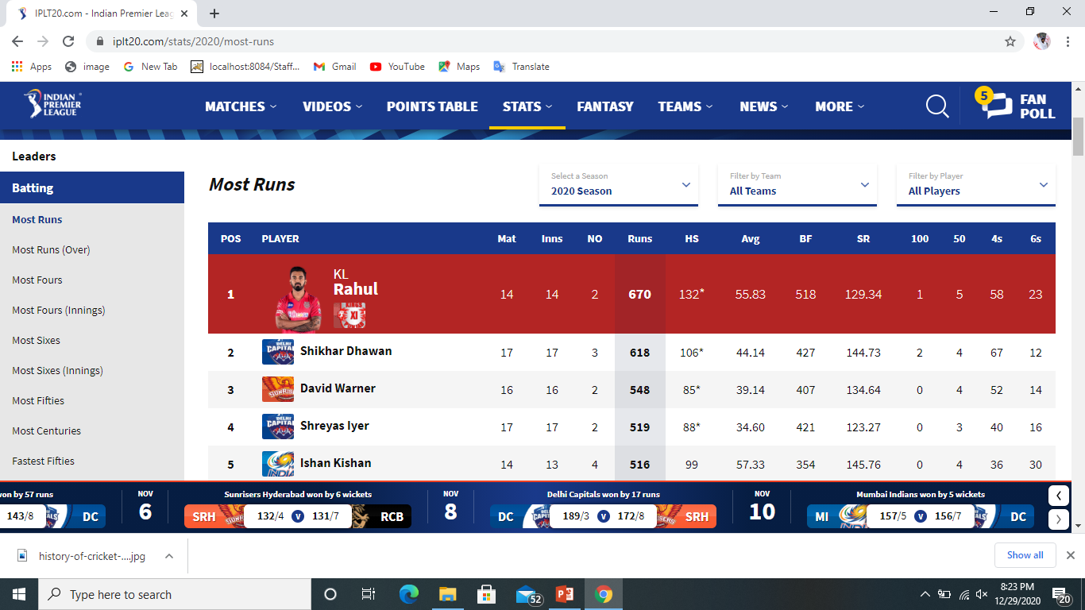
Description: We Scrap the data from the seasons of IPL 2015-2020 and extract the stats of 100 players from each season

Slide 3
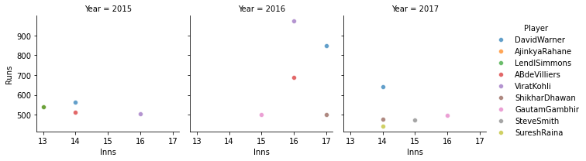
The Below plot is used to analyze the runs scored by the Top5 players in seasons 2015-2017

Slide 4
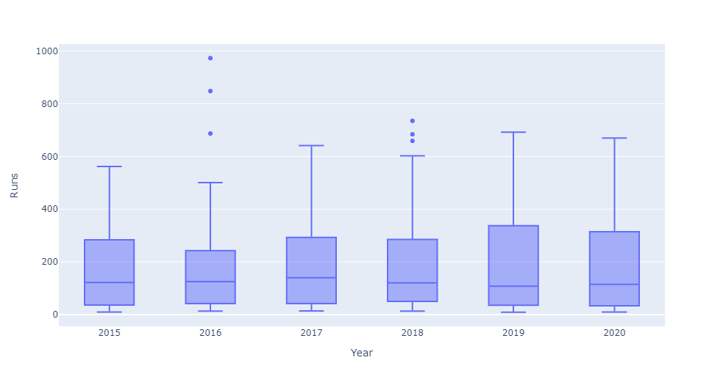
Comparing the runs in seasons 2015-2020 by using the box plot

Slide 5
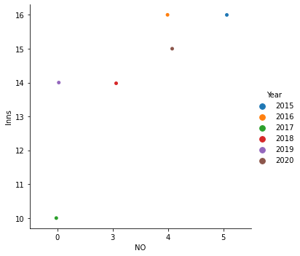
This plot shows in how many innings Virat Kohli remained notout’s in seasons 2015-2020

Slide 6
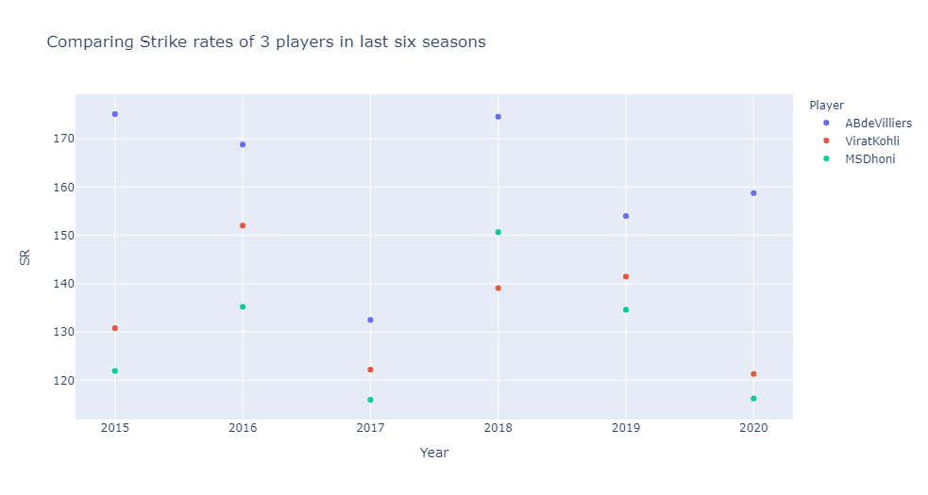
This below plot is used to analyze the strike rate of 3 players in ipl seasons 2015-2020

Slide 7
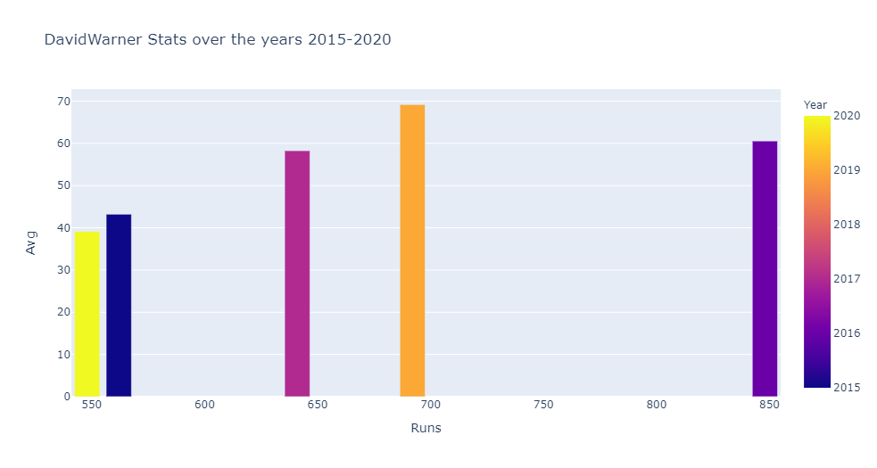
This Bar plot shows the stats of Runs and Average of DavidWarner in ipl seasons 2015-2020

Slide 8
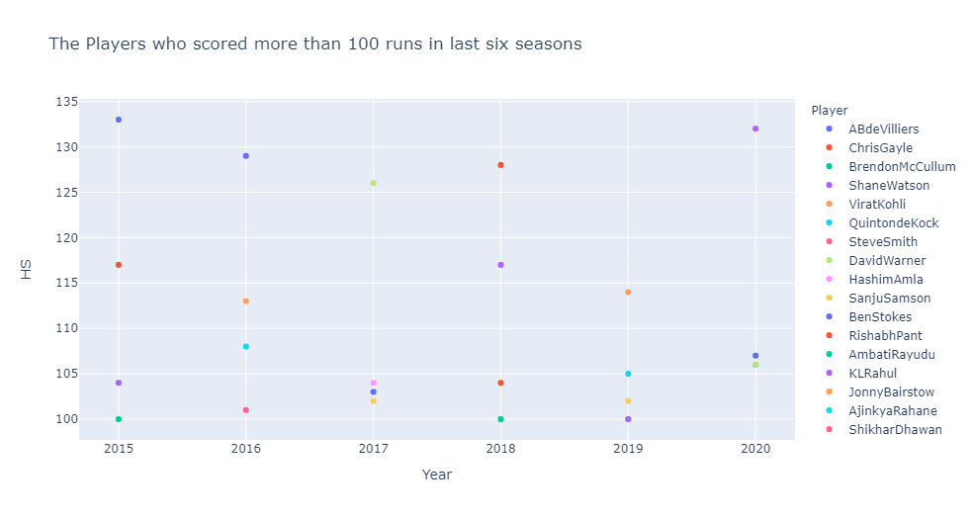
This plot shows details of players who scored centuries in last six seasons

Slide 9
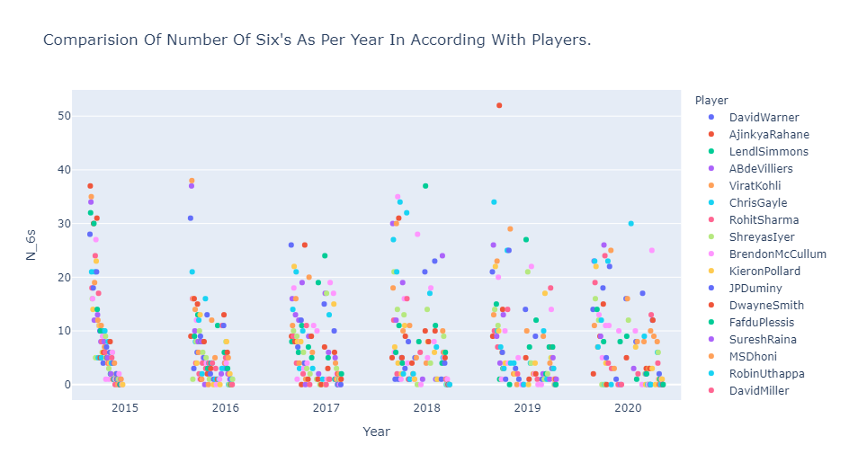
Comparision of Number of Six's scored by players in seasons 2015-2020, According to below plot Andre Russel hit 52 Six's which is comparatively greater than all the players in the seasons 2015-2020.

Slide 10
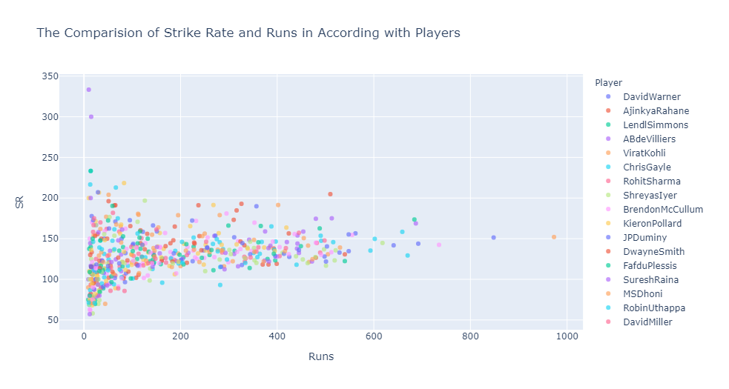
The Comparision of players with highest Strike Rate with lowest runs and also we observe the player with more than 200 strike rate with more than 500 Runs

Slide 11
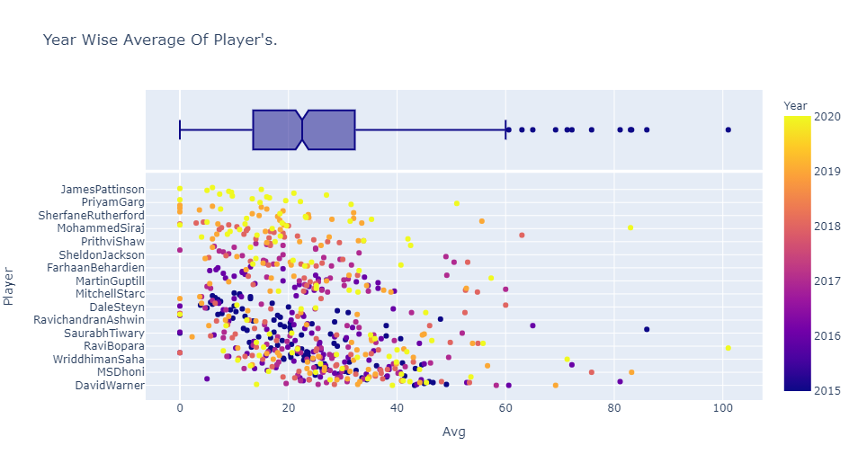
Some Of The Players Had Extremely High Average As Per Year and Those Players We Can Observe In The Box Plot They are Considered as Outliers.

Slide 12


